Slide 1
Creating Enthusiasm for Learning
4:20 Welcome & What it means to pursue enthusiasm as a teacher audio
William H. Murphy, PhD
website: www.williamhmurphy.com

Slide 2
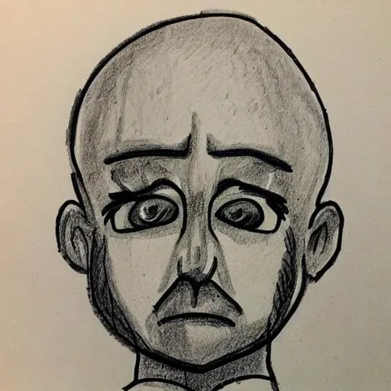
helplessness
depression
anger
resignation
The prison bars deny you the now. You are forced to always think about the past or the future.
E. Leo Foster, The Exiles
4:25 Mindset of a Prisoner audio

Slide 3
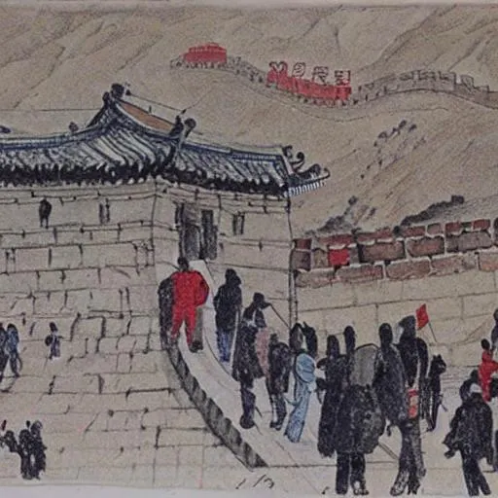
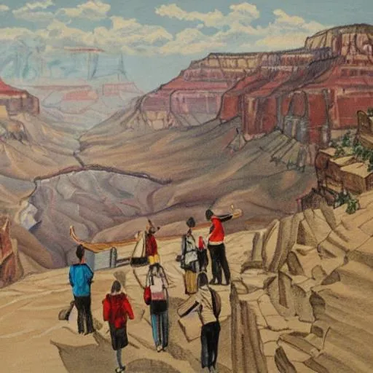
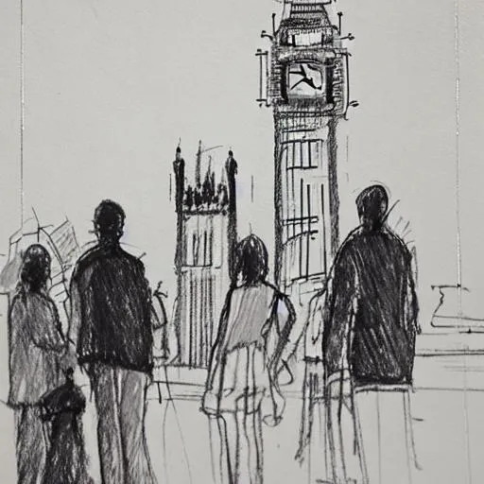
I can't think of anything that excites a greater sense of childlike wonder than to be in a country where you are ignorant of almost everything.
Bill Bryson
3:06 Mindset of a Tourist audio

Slide 4
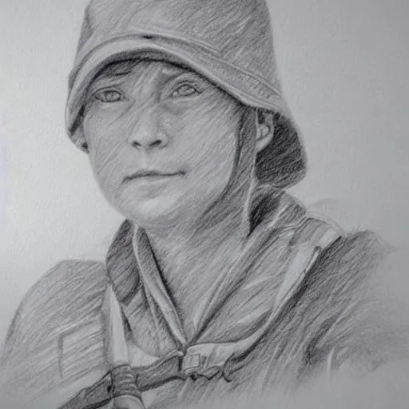
Curiosity
Resilience
Creativity
Courage
Open- mindedness
Wherever you look, there are still things we don’t know about and don’t understand. [...] There are always new things to find out if you go looking for them.
David Attenborough
3:06 Mindset of an Explorer audio

Slide 5
Big Questions we should ask ourselves
Why should students care about the class I am about to teach?
It is required.
Won’t graduate/advance without this class.
Material from lecture might be on the exam.
It is interesting.
It has a role in making me better in becoming the me I intend to become.
It could change my life.
How will I take students from ME being the only person excited about this topic to WE being excited about this topic?
4:44 Motivation and Big Questions Teachers Should Ask Themselves audio
https://www.facultyfocus.com/articles/teaching-and-learning/why-do-i-need-to-know-this/
Notes:
There needs to be a separate list that identifies those “hidden” skills that students acquire in the process of learning the content. And not only do students need to hear what those objectives are, they need to know why they are important.

Slide 6
Students are tuned into a radio station….
Motivation
Enthusiasm
Desire
Drive
Passion
I will be changed by knowing this
The sea, once it casts its spell, holds one in its net of wonder forever.
Jacques Cousteau
3:35 Students are Tuned into a Radio Station & Building Trust audio

Slide 7
“Catch”
“Hold”
Spark Interest
Induce Effort & Develop Ability
Assess Performance toward goals
Material
Methods
Teacher
Vivid
Video
Varied
Lecture
Voice
Novel
Dynamic
Relevant
Current
Groups
Interactive
Enthusiastic
Smile
3:13 Catching & Holding our Students via Coaching audio

Slide 8
Provoking effort:
task value / expectations
authentic tasks related to goal achievement
allow choice / autonomy where possible
personally significant topic, context
provide encouragement/praise/recognition
“you can do it” and “great question!”
They may forget what you said — but they will never forget how you made them feel.
C. W. Buehner
5:16 Authentic Tasks & Giving Students Choice audio
I have not failed. I've just found 10,000 ways that won't work.
T. A. Edison
Notes:
Authentic Task: An assignment given to students designed to assess their ability to apply standard-driven knowledge and skills to real-world challenges.

Slide 9
Useful rules for teaching
If I don’t enjoy it, my students won’t enjoy it.
Believe that I make a difference.
Explain why I teach how I teach.
A great teacher is never a finished product but rather always in the process of becoming.
T.E. Cronin
3:23 Useful Rules for Teaching audio

